Slide 1
VA.gov Home Page Visualizations
Cindy Merrill, May 2021
Based on Baseline Wayfinding research and Analytics

Slide 2
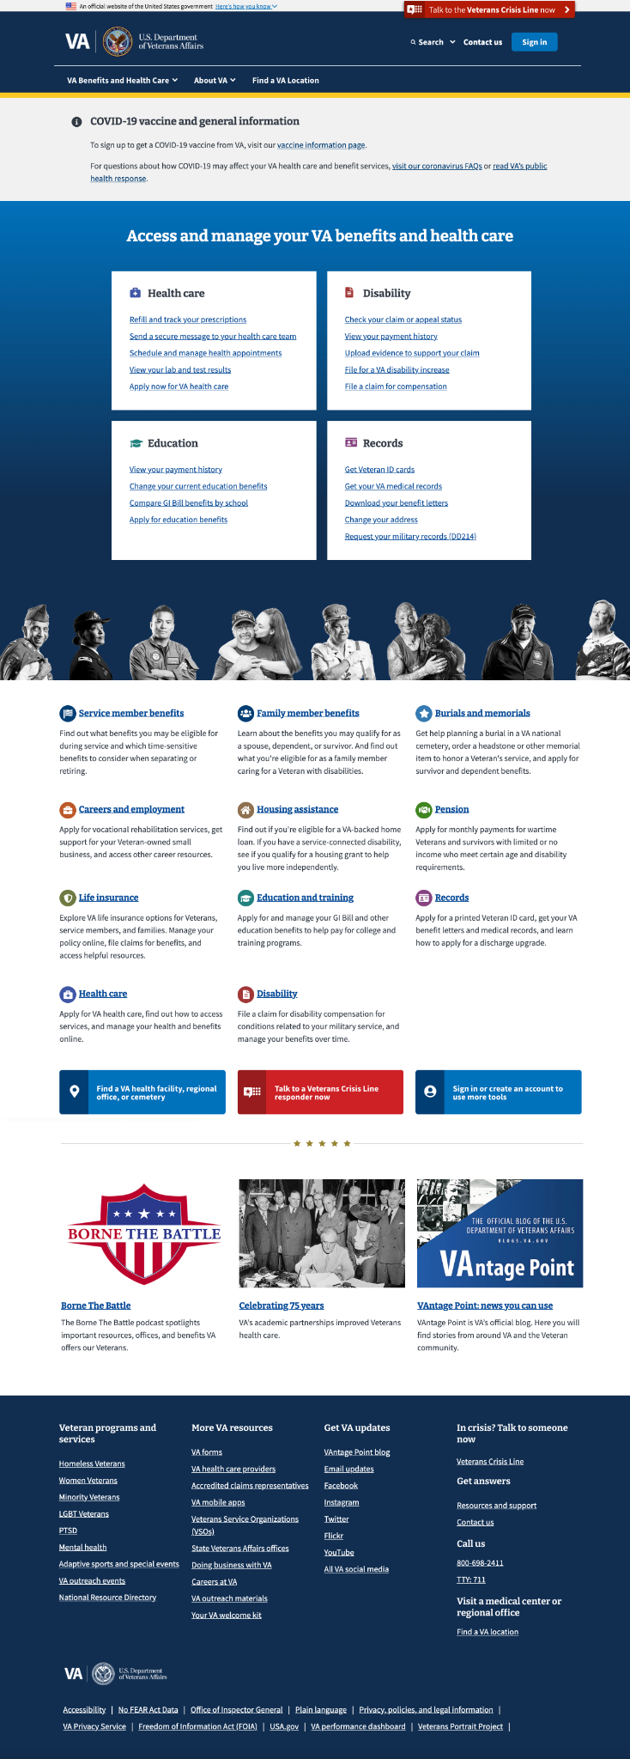
Areas of the VA.gov home page (Desktop)
Header
“Top 4” boxes
Topics below the pictures
3 wide buttons
3 pictures w/links
Footer

Slide 3
Some important links on the home page (Desktop)
VA Benefits and Health Care megamenu
Site Search
Find a VA Location
Find a VA Location
Resources & Support
VA Forms
Find a VA Location

Slide 4
% of 8 research participants who clicked in each area (Desktop)
33%
56%
56%
11% (other header links)
Where people clicked (decreasing order):
“Top 4” boxes
Search and Find a VA Location in the header
VA Benefits and Health Care megamenu, topics and wide buttons below the row of pictures, VA Forms in the footer
Resources and Support in the footer
Find a VA Location in the footer and other header and footer links
89%
Key:
75-100%
50-75%
25-49%
10-24%
0-9%
33%
33%
0%
33%
22%
11% (other footer links)
11%

Slide 5
# of unique clicks in a month per analytics (Desktop)
105K
51K
69K
63K (other header links)
Where people clicked (decreasing order):
“Top 4” boxes
VA Benefits and Health Care megamenu
Search in the header
Other header links including Find a VA Location
VA Forms in the footer
Topics below the row of pictures
3 wide buttons below the links
Footer links, including Resources and Support, Find a VA Location
117K
Key:
> 100K
50-99K
20-49K
10-19K
0-9K
19K
5K
<1K
20K
4K
Note: Data from unauthenticated navigation from 3/24/2021 - 4/22/2021 unique events (top # per screen area)
8K (other footer links)
3K
Notes:
Data comes from top events (clicks) on home page from 3/24/2021 - 4/22/2021
In the header, the Sign In link was > 100K, but other links were a lot less. Color here reflects the non-Sign In links (and unauthenticated state of the page) in order to directly compare with user research data (all unauthenticated).

Slide 6
Compare home page usage per research and analytics (Desktop)
Similarly high usage in “top 4” boxes and header
Lower usage farther down the page, except for VA Forms in the footer
Research
Analytics
Key:
High
Low

Slide 7
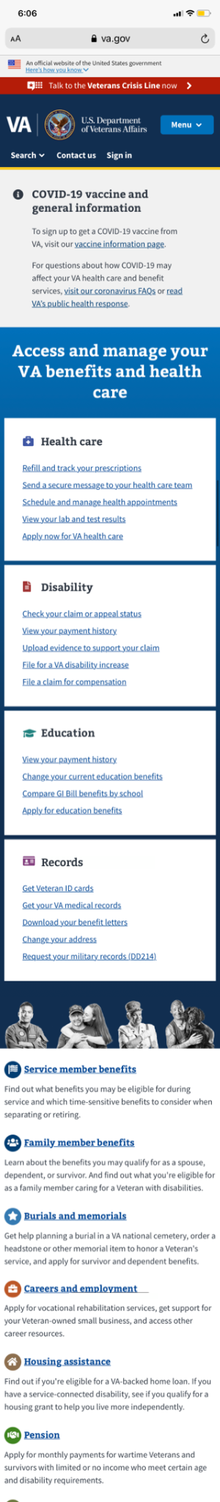

Areas of the VA.gov home page (Mobile)
Header
Topics below the pictures (more)
3 wide buttons
“Top 4” boxes
3 pictures w/links
Topics below the pictures
Footer

Slide 8
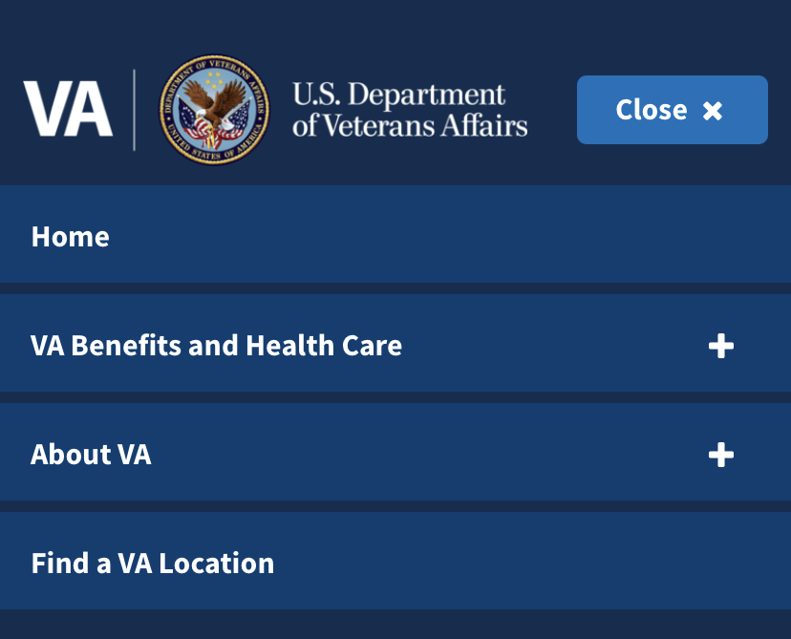
Some important links on the home page (Mobile)
Site Search
Menu button
Find a VA Location
Find a VA Location
Contact Us to see Resources & Support, Find a VA Location
VA Benefits and Health Care megamenu
More VA resources to see VA Forms

Slide 9
% of 5* research participants who clicked in each area (Mobile)
20% (other header links)
80% (search)
Where people clicked (decreasing order):
“Top 4” boxes and Search in the header
Menu > VA Benefits and Health Care megamenu
Menu > Find a VA Location
Other header links and wide buttons
80% (search)
20%
60%
Key:
75-100%
50-75%
25-49%
10-24%
0-9%
40%
80%
0%
0%
0%
*4 participants were on smartphones and 1 used a tablet

Slide 10
# of unique clicks in a month per analytics (Mobile)
Note: The header isn’t used much, except for the VA Benefits and Health Care megamenu and Search
2K (other header links)
Where people clicked (decreasing order):
“Top 4” boxes
Menu > VA Benefits and Health Care megamenu
Search in the header
Topics below the row of pictures
Menu > Find a VA Location
Wide buttons
Footer links including VA Forms, Resources and Support, Find a VA Location
22K (search)
6K
103K
Key:
> 100K
50-99K
20-49K
10-19K
0-9K
6K
309K
<1K
9K
3K
Note: Data from unauthenticated navigation from 3/24/2021 - 4/22/2021 unique events (top # per screen area)

Slide 11
Compare home page usage per research and analytics (Mobile)
Similarly high usage in “top 4” boxes, VA Benefits and Health Care megamenu, and Search
Lower usage elsewhere
Research
Analytics
Key:
High
Low

